Slide 1
James Harden Breakdown
Akshat Pegallapati
July 2024

Slide 2
Outline
Introduction
Methodology
Results
Visualizations and Takeaways
Discussion
Conclusion

Slide 3
Introduction
Goal
Understand James Harden’s performance throughout his career and highlight key factors affecting his performance
Key Topics:
Career Statistics Overview (Playoffs vs Regular Season)
Home vs Away Game 2023-2024 Regular Season Performance
Statistics vs Opponents 2023-2024 Regular Season Performance
Shot Chart Analysis
Data Source
NBA API for statistics and game logs

Slide 4
Methodology
Collected data from NBA API for James Harden’s Career
Done using Python
Refined the data using Python
Used Pandas Library to achieve this
Created new columns for per game averages from original data
Exploratory data analysis using Python
Used matplotlib and Pandas library
Studied the correlations between the data
Data Visualization with Python
Used matplotlib and seaborn libraries in Python
Dashboard Creation using IBM Cognos Analytics

Slide 5
Results
The visualizations and takeaways are in the following slides

Slide 6
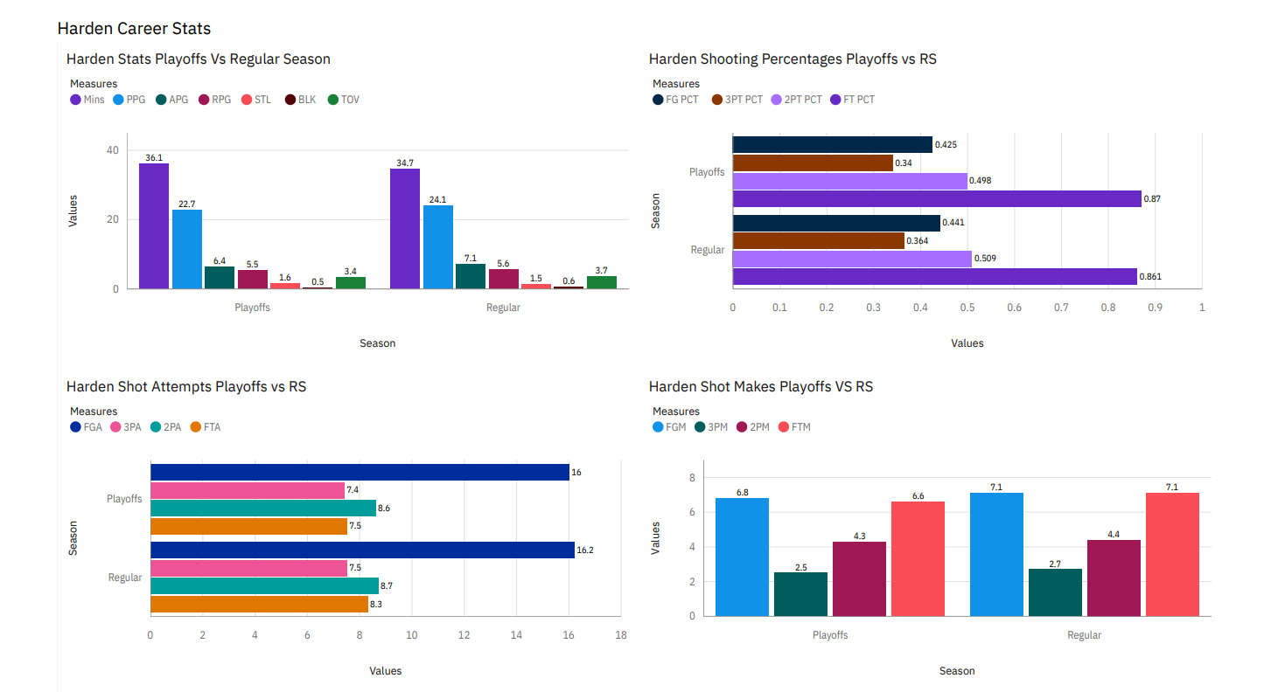
Career Playoffs vs Regular Season Stats

Slide 7
Career Playoffs vs Regular Season Findings
Over Harden’s Career his stats in the playoffs and regular season are similar
Harden’s Points and Rebounds are the biggest difference in his stats between the regular season and playoffs
Harden’s shot attempts nearly identical for his career in both the playoffs and regular season
Harden’s shots made are consistent in both the regular season and playoffs for his career
Harden averages about 1 less free throw attempts in the playoffs
Harden’s averages less points in the playoffs due to his fall in shooting percentages and lower free throw attempts

Slide 8
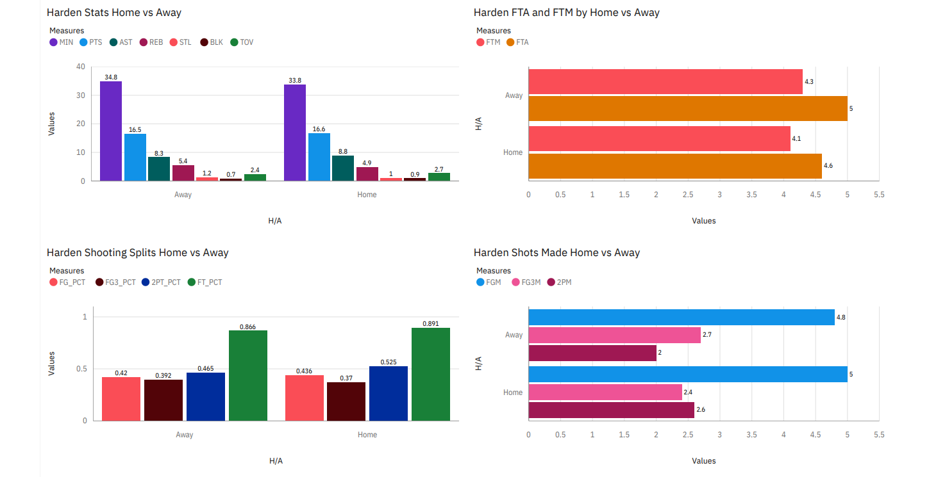
Home vs Away Stats from 2023-2024 Regular Season

Slide 9
Home vs Away Stats from 2023-2024 Regular Season Findings
Harden’s stats are very similar between home and away games
Harden averaged more free attempts per game on the road instead of at home
Harden’s shots made are consistent in both home and away games, with the biggest difference in two pointers
Harden only shoots better from the three-point line in away games
Harden shoots better overall in home games
Through looking at the stats James Harden is unaffected by the game's location as his overall stats between home and away games are very similar

Slide 10
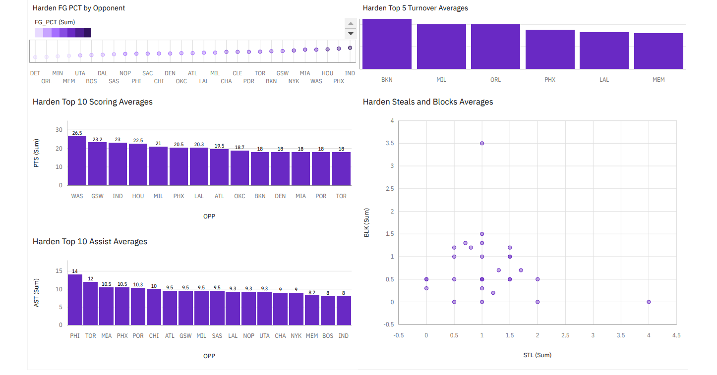
Harden Stats by Opponents 2023-2024 Regular Season

Slide 11
Harden Stats by Opponents 2023-2024 Regular Season Findings
Harden’s stats best scoring average was against the Wizards with 26.5 points
Harden’s best assist average came against his previous team the 76ers with 14 assists
Harden’s best shooting percentage from the field came against the Suns in which he shot an average of 64.4 % over 2 games
Harden’s worst turnover average came against the Nets as he averaged 4.5 turnovers per game
Harden’s best stocks (steals + blocks) average of 4.5 came against the Wizards
The Washington Wizards are the opponent that Harden played the best against as he averaged 26.5 PPG, 6.5 APG, 6.5 REB, 1 SPG, 3.5 BPG, and shot 57.1% from the field, 57.9% from 3, and 100% from the free throw line

Slide 12
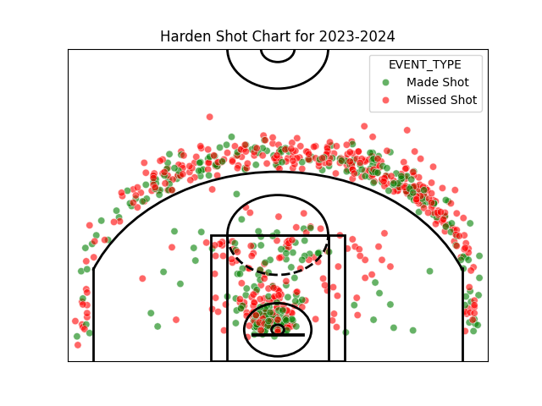
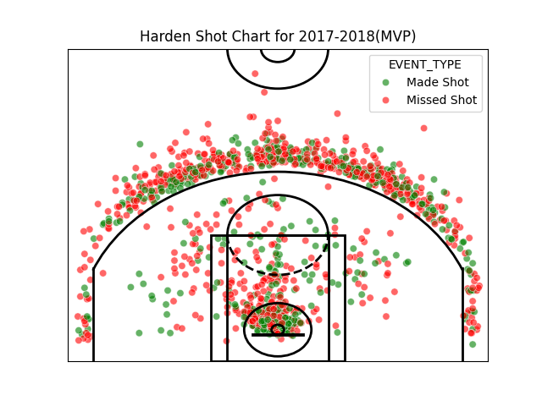
Harden Shot Charts

Slide 13
Harden Shot Charts Findings
In the 2017-2018 regular season most of Harden’s shot attempts were either 3’s or right at the rim
In 2023-2024 regular season Harden’s shot attempts follow the same pattern as above
In 2023-2024 regular season Harden has fewer shot attempts compared to his MVP year and this points out how his role has changed since then
Despite having lost a step since his hamstring injury in Brooklyn, he still is able to get to the rim and has not utilized the midrange heavily in his shot selection
Harden’s shot attempts throughout his career since his Houston days have been heavily influenced by analytics and despite playing for various teams most of his shot attempts continue to be from 3 or layups

Slide 14
Discussion
Findings
Harden’s overall stats have a slight difference between regular season and the playoffs due to his efficiency and free throw attempts
Harden performed equally well at home and on the road in the past regular season
The Wizards are the team against which Harden played the best in 2023-2024 regular season
Harden’s shot attempts are mostly 3’s or right at the rim
Implications
The narrative that Harden performs much worse in the playoffs is wrong, as his production drops marginally
Harden is unaffected by the location of the game
Look for the Wizards to be a team Harden plays well against next season if they have a similar roster
Harden’s shot attempts seem unlikely to change for the future as the trend shows he mostly shoots 3’s and layups

Slide 15
Conclusion
Harden’s playoffs stats should be very similar to his regular season stats following his overall career stat differences
Harden has shown shooting efficiency differences in home and away games, but his overall stat output is roughly the same showing that home and away games don’t influence his output
Harden played well against most of the young teams and contending teams
Harden’s shot attempts continue to follow his trend of 3’s and layups, and his decline in production is due to the change of his role with the Clippers of being a third option

